Slide 1
Intelligent Management Prototype
Phase V
Risk-based Task Recommendation via Machine Learning Techniques

Slide 2
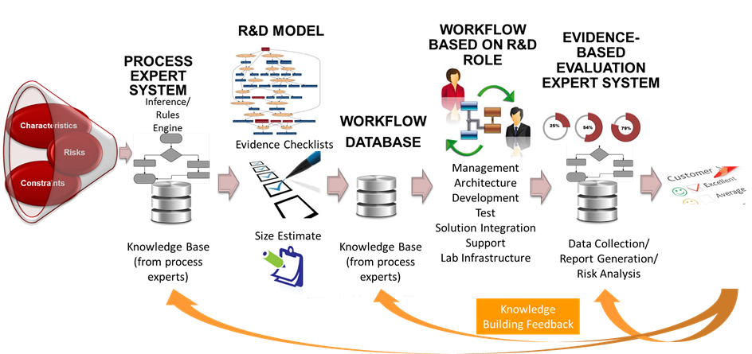
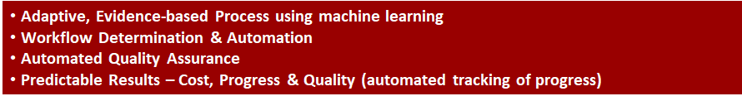
Scope & System Architecture

Slide 3
Accomplishment to Date
Workflow/Evidence Determination & Risk Analysis
Effort Estimates & Evidence Analysis
Automated Quality Assessment Using Data Normalization Architecture
Phase IV
AI/Machine learning (ML) techniques and principles to demonstrate automatic revisions to the development process, using Incremental Commitment Spiral Model (ICSM) and automated Quality Assurance.
The TR4 milestone is the use case and data from the following sources is used for analysis/learning: Development Risk drivers, Defect Prediction factors, Huawei's Quality Management database, and static code analysis.
Phase V
Integrate risk prediction model with advanced tollgates of system prototype.
Explore open source project data to improve risk prediction model.

Slide 4
Overview
Operational Concept
Potential Data Sources
Learning Risk Prediction Model
Intelligent Risk Mitigation
Demo
Conclusions
Next Steps

Slide 5
Artificial Intelligence in Software Engineering
The Solutions:
Industry (Companies/Products/Platforms B2B Ready):
Code Construction / Configuration,
Quality Management / Testing,
Maintenance;
Academic (Researches):
Requirements, UCDD NARCIA RETA(RUBRIC)
Code Construction / Configuration; DeepCoder FlashMeta RobustFill
Potential Fields:
Design, Project Management;
Source: Valentin Grigoryevskiy, AI for Software Engineering - Industry Landscape (18/Oct/2017)

Slide 6
Operational
Concept

Slide 7
At each anchor point / milestone within the software development lifecycle,
The system
quantifies risks based on a set of criteria tracked from existing data source,
then redirects to different tasks based on the potential risks.
...
In order to present a concrete idea, current anchor point / milestone is set to
TR4

Slide 8
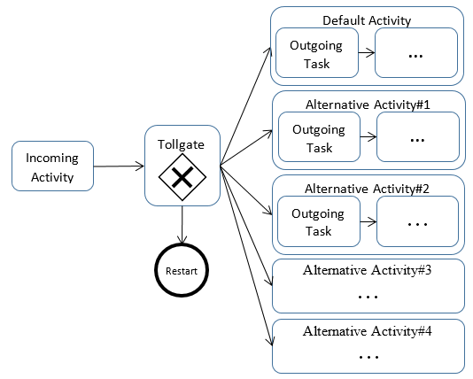
Terms
Workflow
Describes the roles and tasks involved in activities.
Modeled by BPMN2.0 in previous prototype.
Tollgate connects
Incoming activities
which consists of a series of tasks.
Outgoing activities
which consists of a series of tasks.

Slide 9
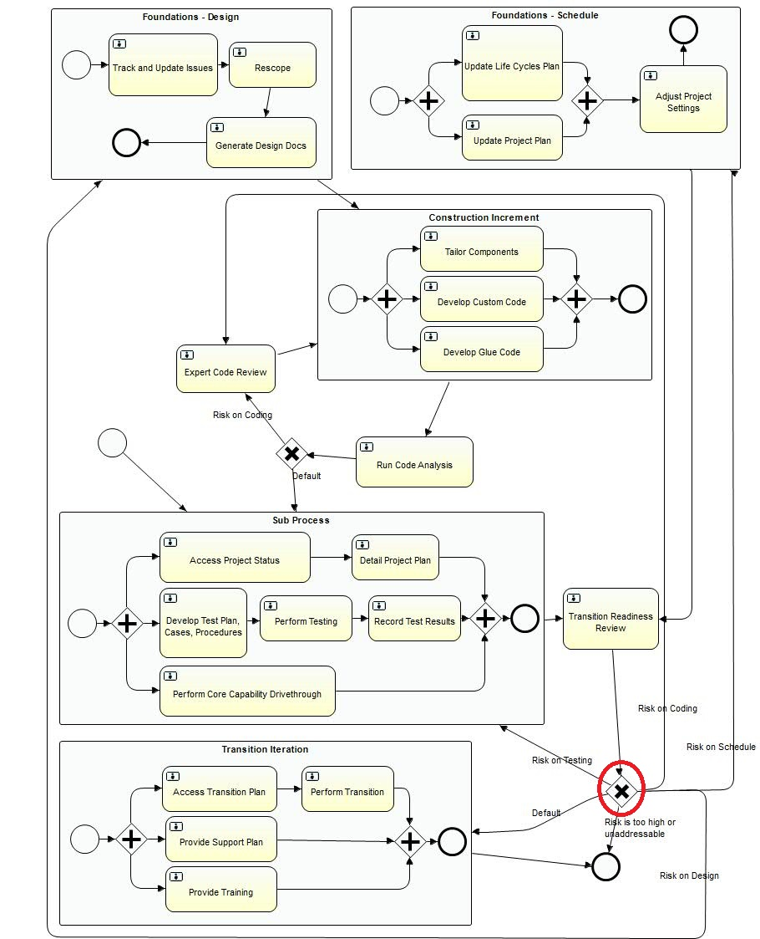
Examples
Notes:
http://ec2-54-67-99-52.us-west-1.compute.amazonaws.com:8686/demo/phase2/dashboard.html?instanceId=29033

Slide 10
Potential
Data Sources

Slide 11
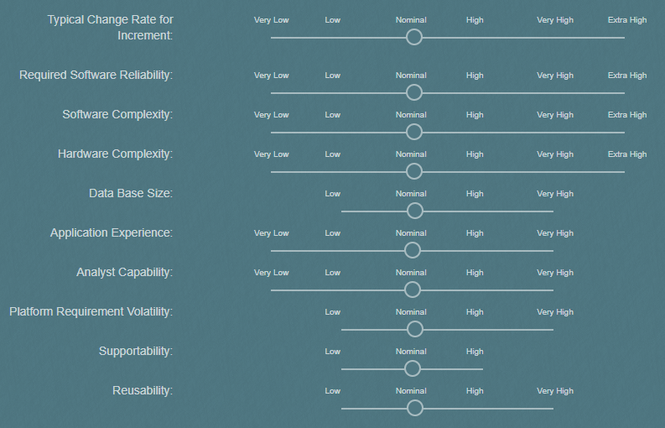
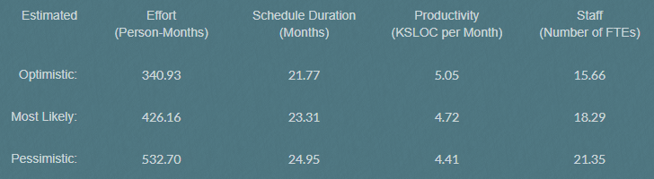
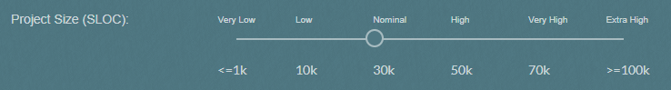
Development Risk Drivers from Project Initialization
Expressive factors while initializing a project
22 factors: reflects the product, process, personnel, and platform of the project.
Have been integrated into the current prototype
Based on Dr. Barry Boehm’s study of Constructive Cost Model (COCOMO)
Notes:
There are 22 cost drivers in total, which have been input into the system when initiating a project. They largely reflect the product, process, personnel, and platform aspects of the project, which may generally affect risk exposure and mitigation. The number of cost drivers to adopt in the model depends on the amount of data we can assume in order to avoid overfitting, and the development environment of Huawei

Slide 12
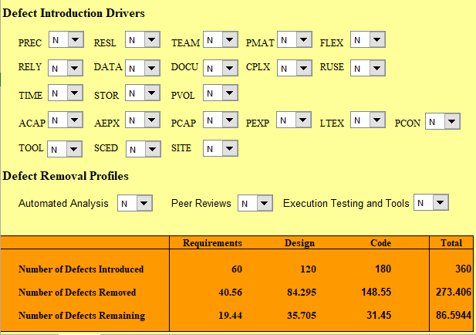
Defect Prediction Factors
3 Baseline Defect Rates in addition to the project initialization settings
Automated Analysis
Peer Reviews
Level of Testing Sophistication
Based on Dr. Raymond Madachy’s study of Constructive Quality Model (COQUALMO)
Notes:
It predicts defects introduced and removed based on a subset of COCOMO cost drivers and three internal baseline defect rates, specifically, for automated analysis, peer reviews, and execution testing and tools. The prediction helps to risk identification and mitigation.

Slide 13
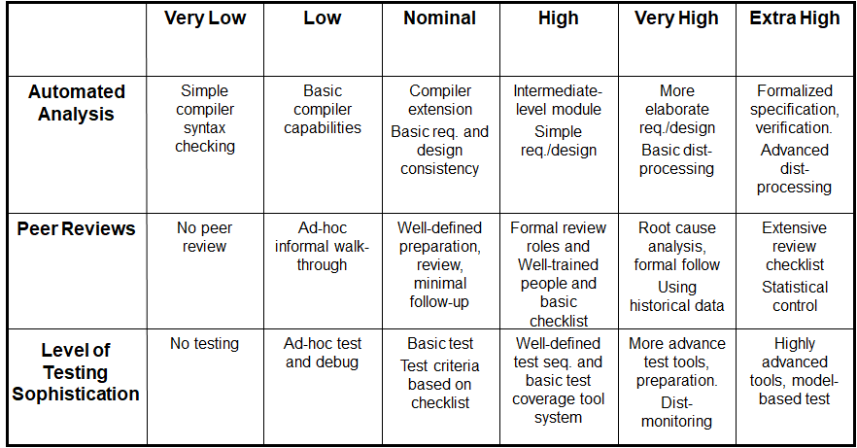
Defect Removal Rating Scales

Slide 14
Code Repository Analysis (SQUAAD)
Understanding Software Quality Evolution Using SQUAAD
Two approaches
Absolute value of quality attributes after each commit
Impact of developers on quality attributes at each commit
Quality Attributes
A collection of 50+ metrics
Example
M1: Code Smells
M2: Security Vulnerabilities
How can we use this data?
If the number of code smells (M1) exceeds a certain amount maintenance tasks should get higher priority.
If the number of security vulnerabilities (M2) has increased in the last commit maintenance tasks should get higher priority.
SQUAAD is a tool from USC-CSSE to evaluate code evolution for open source projects (by Pooyan Behnamghader).

Slide 15
List of All Metrics
Tool: SonarQube Classes Comment_lines_density Vulnerabilities Lines Ncloc Complexity Security_rating Major_violations Duplicated_blocks Code_smells File_complexity Functions Duplicated_files Duplicated_lines_density Reliability_rating Critical_violations Violations Statements Blocker_violations Reliability_remediation_effort | Duplicated_lines Bugs Security_remediation_effort Directories Info_violations Sqale_index Sqale_debt_ratio Minor_violations Files Sqale_rating Tool: PMD Basic Emptycode Clone implementation Comments Codesize String and stringbuffer Naming Strict exceptions Optimization | Design Security code guidelines Braces Type resolution Coupling Finalizer Import statements Unused code Unnecessary Tool: FindBugs Security I18n Mt_correctness Style Experimental Correctness Malicious_code Bad_practice Performance

Slide 16
Code Smells (SQUAAD)
A maintainability-related issue in the code.
Leaving it as-is means that at best maintainers will have a harder time than they should making changes to the code.
At worst, they'll be so confused by the state of the code that they'll introduce additional errors as they make changes.
Example:
Child class fields should not shadow parent class fields.
Having a variable with the same name in two unrelated classes is fine, but do the same thing within a class hierarchy and you'll get confusion at best, chaos at worst.
NONCOMPLIANT CODE EXAMPLE
public class Fruit { protected Season ripe; protected Color flesh; // ... } public class Raspberry extends Fruit { private boolean ripe; // Noncompliant private static Color FLESH; // Noncompliant }
COMPLIANT SOLUTION
public class Fruit { protected Season ripe; protected Color flesh; // ... } public class Raspberry extends Fruit { private boolean ripened; private static Color FLESH_COLOR; }
Notes:
Code Smells
Code smell, also known as bad smell, in computer programming code, refers to any symptom in the source code of a program that possibly indicates a deeper problem. According to Martin Fowler, "a code smell is a surface indication that usually corresponds to a deeper problem in the system" (WikiPedia)

Slide 17
Security Vulnerabilities (SQUAAD)
A security-related issue which represents a potential backdoor for attackers.
Example:
SQL binding mechanisms should be used
Applications that execute SQL commands should neutralize any externally-provided values used in those commands.
Failure to do so could allow an attacker to include input that changes the query so that unintended commands are executed, or sensitive data is exposed.
public User getUser(Connection con, String user) throws SQLException { Statement stmt1 = null; Statement stmt2 = null; PreparedStatement pstmt; try { stmt1 = con.createStatement(); ResultSet rs1 = stmt1.executeQuery("GETDATE()"); // Compliant; parameters not used here stmt2 = con.createStatement(); ResultSet rs2 = stmt2.executeQuery("select FNAME, LNAME, SSN " + "from USERS where UNAME=" + user); // Noncompliant; parameter concatenated directly into query pstmt = con.prepareStatement("select FNAME, LNAME, SSN " + "from USERS where UNAME=" + user); // Noncompliant; parameter concatenated directly into query ResultSet rs3 = pstmt.executeQuery(); //... } public User getUserHibernate(org.hibernate.Session session, String userInput) { org.hibernate.Query query = session.createQuery( // Compliant "FROM students where fname = " + userInput); // Noncompliant; parameter binding should be used instead // ... }
Notes:
Security Vulnerability
Common Weakness Enumeration (CWE™) is a formal list or dictionary of common software weaknesses that can occur in software's architecture, design, code or implementation that can lead to exploitable security vulnerabilities. CWE was created to serve as a common language for describing software security weaknesses; serve as a standard measuring stick for software security tools targeting these weaknesses; and to provide a common baseline standard for weakness identification, mitigation, and prevention efforts. (SonarQube Security Vulnerabilities)

Slide 18
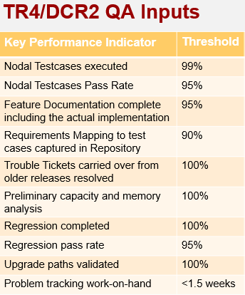
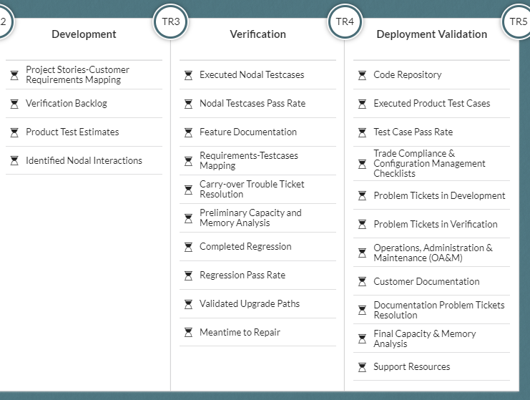
Evidence Criteria
Success Criteria of the Evidence in
TR4

Slide 19
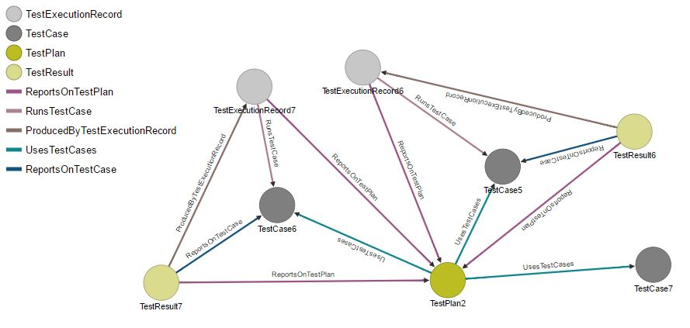
Quality Management Database
From Huawei’s DNA
5 Factors can be used in the current model
FCR (feature completion rate)
CD (number of code defects)
ISS (number of reported issues at the feature level)
ISRR (issue removal rate)
DRR (defect removal rate)
TR4

Slide 20
Issue Resolution Analysis
Understanding Issue Resolution Status
Collect information from JIRA and categorized by milestone
Get to know which of the still-open issues at the end of phase 1 were still open in later phases, as they would be still accumulating technical debt.
Get to know if high-severity issues were given higher priorities for closure.
Factors
ISS_Num_Resolved: # of resolved issues
ISS_Num_Unresolved: # of unresolved issues
Personnel: # of contributors
Estimated_Effort: Estimated total cost
Accu_Trival: Accumulated unsolved issues at Trival Level
Accu_Minor: Accumulated unsolved issues at Minor Level
...

Slide 21
Data Source Categories
Project Settings
Development risk drivers
Defect prediction factors
Runtime States
Issues on Design, Implementation, Testing and Technical Debts
Code Repository Analysis
Issue Resolution Analysis
Quality Management Database
All those required data are supposed to be automatically extracted from different data sources during the runtime.

Slide 22
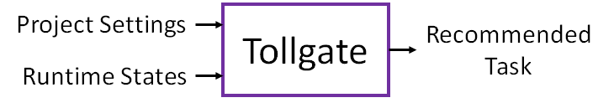
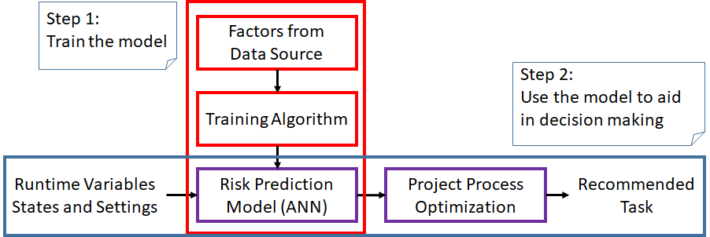
Integration with Machine Learning
...

Slide 23
Learning
Risk Prediction Model

Slide 24
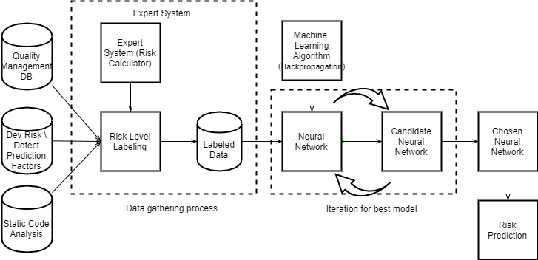
The Model Building Process

Slide 25
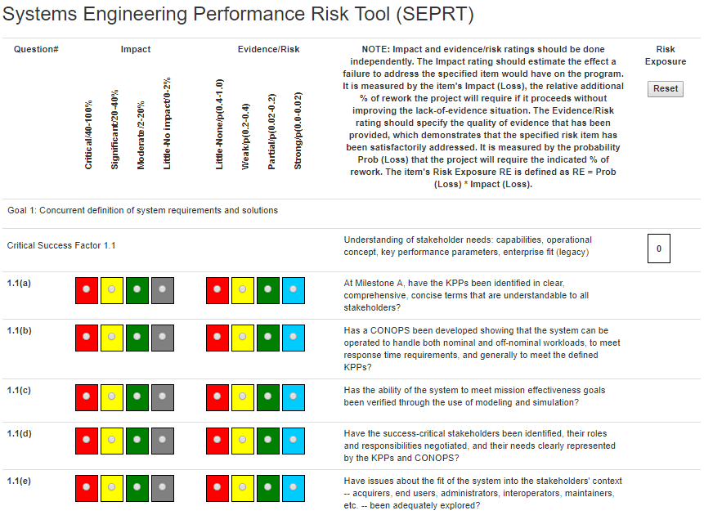
The Data Collection Process
Collecting data points by the inputs of the proposed model
Group X: The results of automatic code static analysis,
Group Y: The inputs from project settings when initializing a project in the system.
Group Z: The data entries from the quality management database (open source project data as supplement).
When put into production, the data assumed by the model will automatically generated/input from the user interface of the expert system. No requirements of extra effort of manually inputting the data.
Labeling data points.
Experienced project Managers label the current status of a project into different levels of risk.
The Risk calculator (developed in phase II) provides the guideline for the experts.
Other Domain knowledge and criteria may also apply, if the expert is confident, for example, by the criteria of being over budget or schedule
Notes:
Collecting data points
Data points described by the inputs need to be collected. The inputs are either input when initiating a project in the system (inputs in group y), the results of automatic analyses (inputs in group x), or the data entries from the quality data base (inputs in group z).
Labeling data points.
It can be done by experienced project managers. The risk calculator (developed in phase II) provides a great guideline for the experts to understand how to label the current status of a project into different levels of risk.
Also, other domain knowledge and criteria (for example, the sample projects being over budget or schedule) can be adopted to label the current status, if the expert is confident about the labeling.

Slide 26
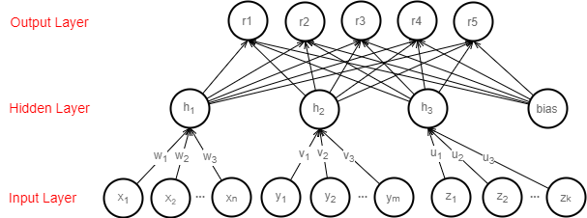
Risk Prediction Neural Network
Classify the current status of a project into five levels of risk based on the defined inputs.
Multilayer Perceptron with 3-layer architecture: Input layer, Hidden layer, and Output Layer.
The neurons in the hidden layer are the general representations of the inputs.
May generalise more hidden layers as needed.
Notes:
A linear function maps the weighted inputs to the output of each perceptron.
Logistic activation function in the output layer to model posteriori probability of the categorical values.
Cross entropy error function is used as the cost function

Slide 27
Current Implementation of Risk Prediction Model
Actual data from Open Source Projects and USC 577 software engineering courses.
Open source projects: ACUMOS - ATT, OPNFV - ATT, APOLLO - Baidu, Carbon Data-Huawei, OpenSDS-Huawei, HYPERLEDGER - IBM.
USC master-level engineering sources: 22 projects.
Simulated data for model training and testing.
500 data points based on covariance matrices of the empirical data.
Using Neuralnet Package in R to train the model.
Demo API is available at our EC2 server
Collect
actual data points
Simulate more data points
Model Training and Testing

Slide 28
Risk Estimation Model based on USC-CSSE Projects
Data Source:
25 Master-level software engineering projects from 2015-2017. Formal method (ICSM) was applied. Those project involved real world clients and delivered complete products.
Measures:
Risk drivers describe the relevant characteristics of a project in terms of personnel, platform, process, and product aspects.
They describe the potential risks from products and platforms.
They describe ability of the people and the process to undertake the risks.
A combination of those factors describes the general bounds of the levels of risks.

Slide 29
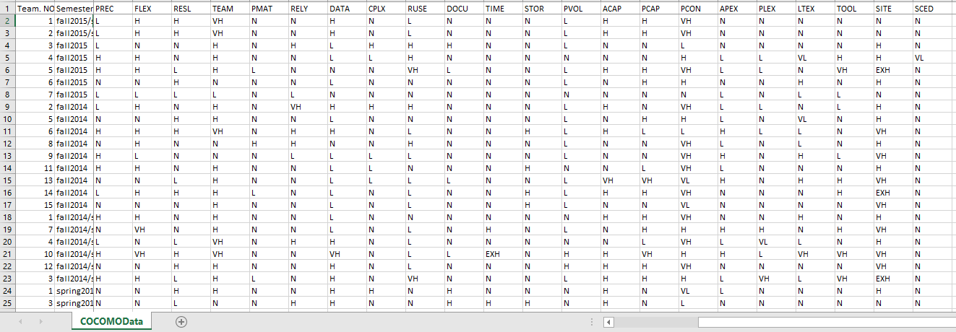
Empirically collected data - Risk Drivers
Development Risk Drivers

Slide 30
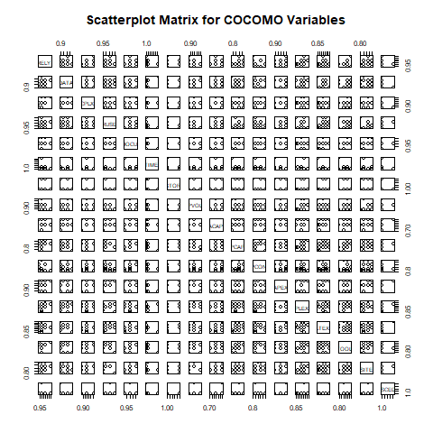
Scatter Matrix for Data Simulation
Scatterplot Matrix for Risk Prediction Factors

Slide 31
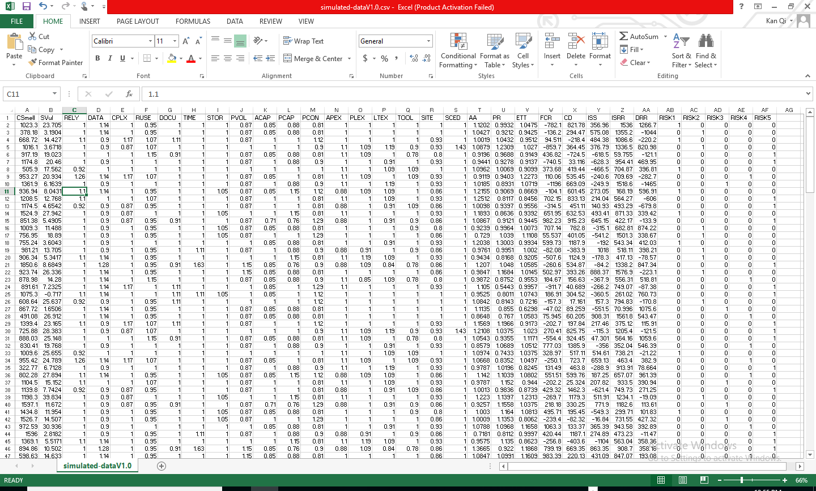
Example of Simulated Data

Slide 32
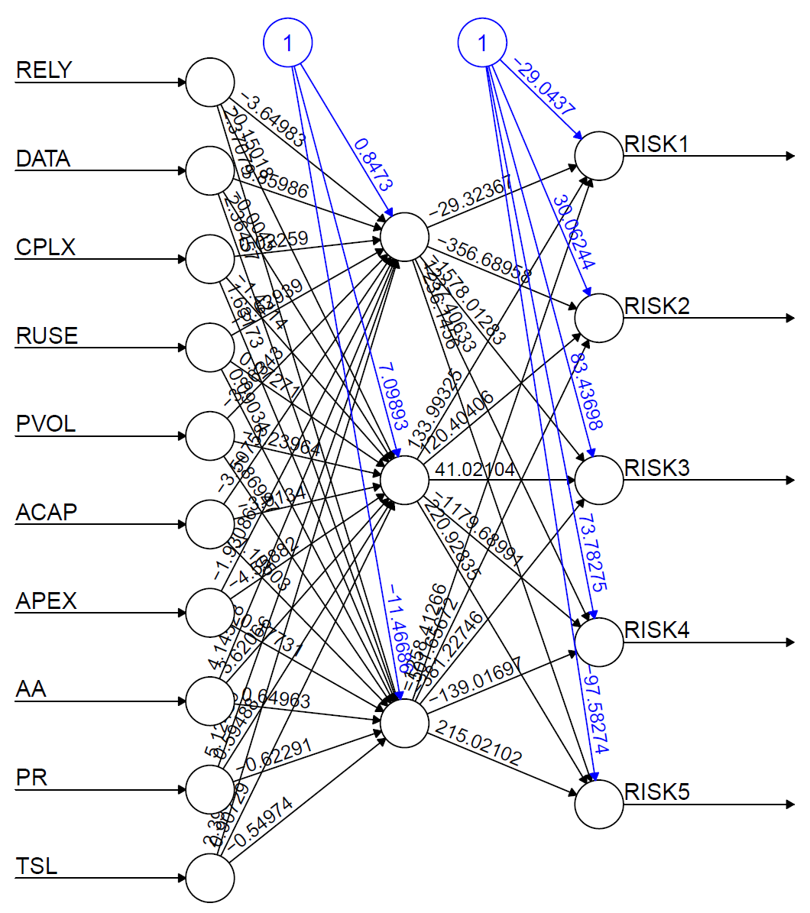
The Trained Neural Network

Slide 33
Risk Prediction Model based on Open Source Projects
1.Explore possibility of building risk prediction models for open source projects.
1.Two open source projects
I. Carbon Data.
II. Fabric Java.
2.What data can be used (Jira and Github are commonly used software engineering tools. Data derived platform is available for production)
1. Jira Repos
I. Release and Milestones.
Related factors in prediction model: Phase
II. Effort tracking report.
Related factors in prediction model: Effort (actual effort), Estimated_Effort (estimated effort)
III. Issue tracking reports: issue creation and resolution reports.
Related factors in prediction model: ISS_Num_Resolved, ISS_Num_Unresolved, Accu_Trivial, Accu_Minor, Accu_Major, Accu_Critical, Accu_Block
IV. Personnel and Contributions.
Related factors in prediction model: Personnel
V. System Modules.
2.Github
I.Commits.
Related factors in prediction model: CSmell, SVul
3.How risk can be evaluated (in following slides).

Slide 34
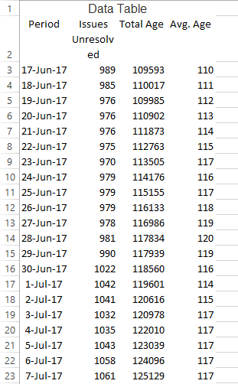
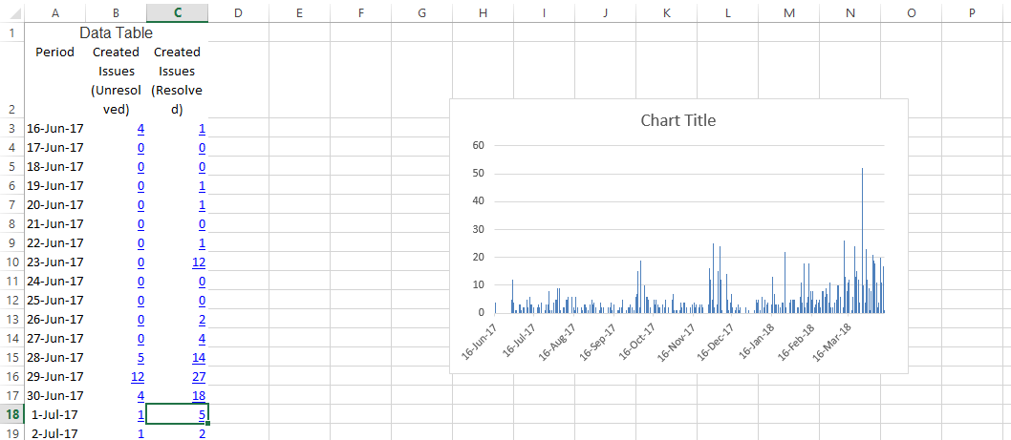
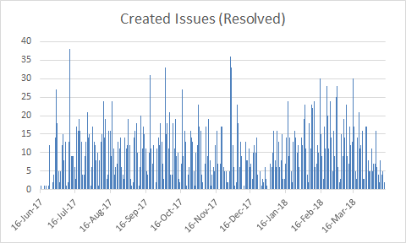
Empirically collected data - Issue Resolution (Jira)
The distribution of creation time indicates the phases - Phase. (If actual definition of phases is available, it would be better)
Issue records provides creation times and resolution times of the issues.
ISS_Num_Resolved, ISS_Num_Unresolved are calculated by Phase using the issue report
Example of issue related datasheet - Age
Example of issue related datasheet - creation times

Slide 35
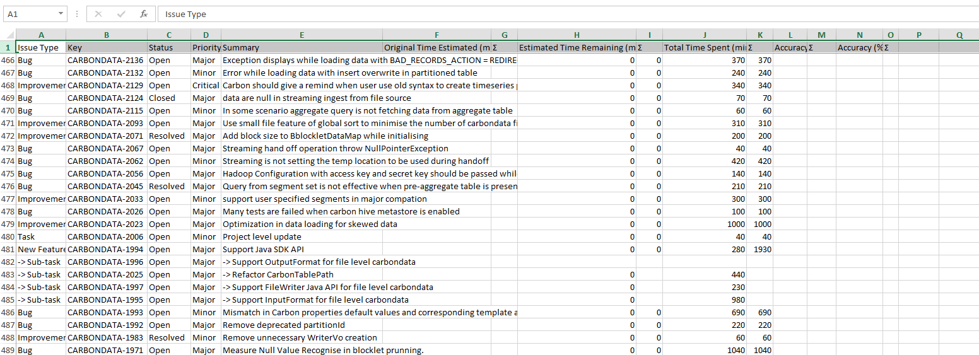
Empirically collected data - Time Tracking (Jira)
Time tracking records provide estimated times and actual times spent on certain tasks.
Effort (actual effort), Estimated_Effort (estimated effort) for each Phase is calculated by the effort spent on the issues that belong to the Phase.
Example of time tracking datasheet.

Slide 36
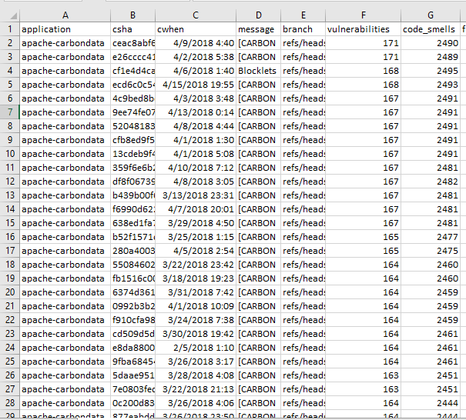
Empirically collected data - Code Analysis (Github)
Code Metrics
Code metrics applied to each commit to measure code quality and technical debt.
Number of Code smells (CSmell) is calculated by commits that belong to Phase
Number of Vulnerabilities (SVul) is calculated
by commits that belong to Phase
* This analytical data is generated by SQUAAD
Example of github commits datasheet.

Slide 37
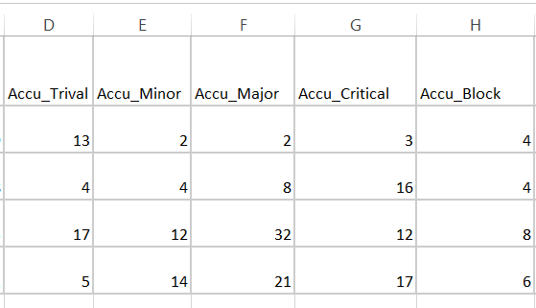
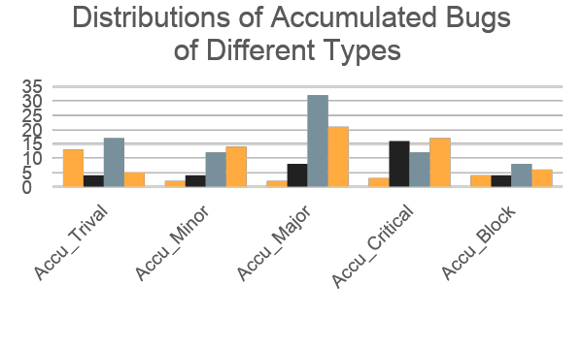
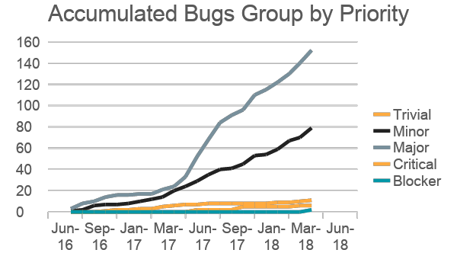
Classified Cumulative Bugs by Severity (Jira)
Accumulated Bugs of different severity reflect the potential technical debt.
Accu_Trivial, Accu_Minor, Accu_Major, Accu_Critical, Accu_Block are determined by categorizing the bugs according to their severity.
Example of empirically collected data for accumulated bugs of different types
Example of distributions of categorized bugs

Slide 38
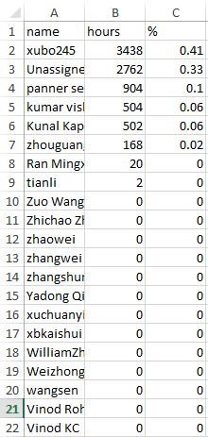
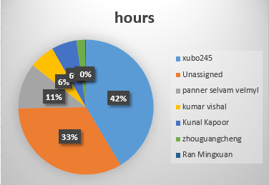
Empirically collected data - Personnel & Contribution (Jira)
Effort distribution over team members identify the contributors, which helps measure the balance of workload.
The distribution of the effort to personnel determines the core contributors, the number of which define the factor Personnel. Contributors who contribute larger than 5% are determined as core contributors.
Effort Distribution to Different Developers
Example of identifying core developers

Slide 39
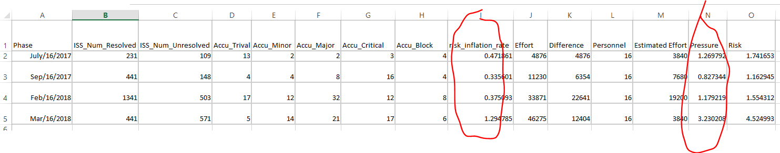
Risk Assessment Metrics based on Open Source Data
The proposed method to measure risk.
Risk_inflation_rate = ISS_Num_Unresolved (number of unsolved issues) / ISS_Num_Resolved (number of solved issues) (at the end of a milestone)
Pressure = Actual_Effort / Estimated_Effort (for each phase)
Risk = Risk_inflation_rate + Pressure

Slide 40
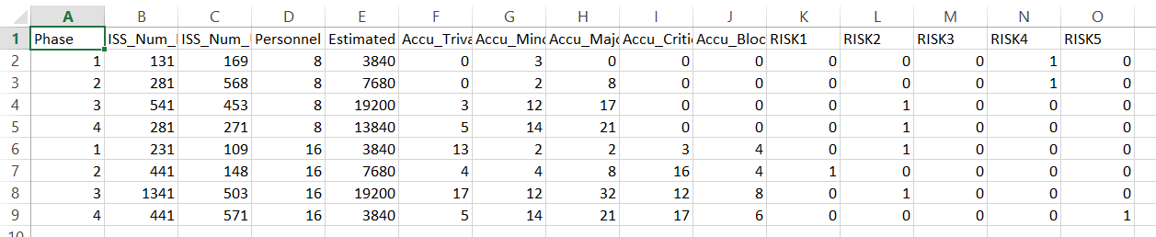
Training Risk Prediction Model
Input Example for the neural network based risk prediction model

Slide 41
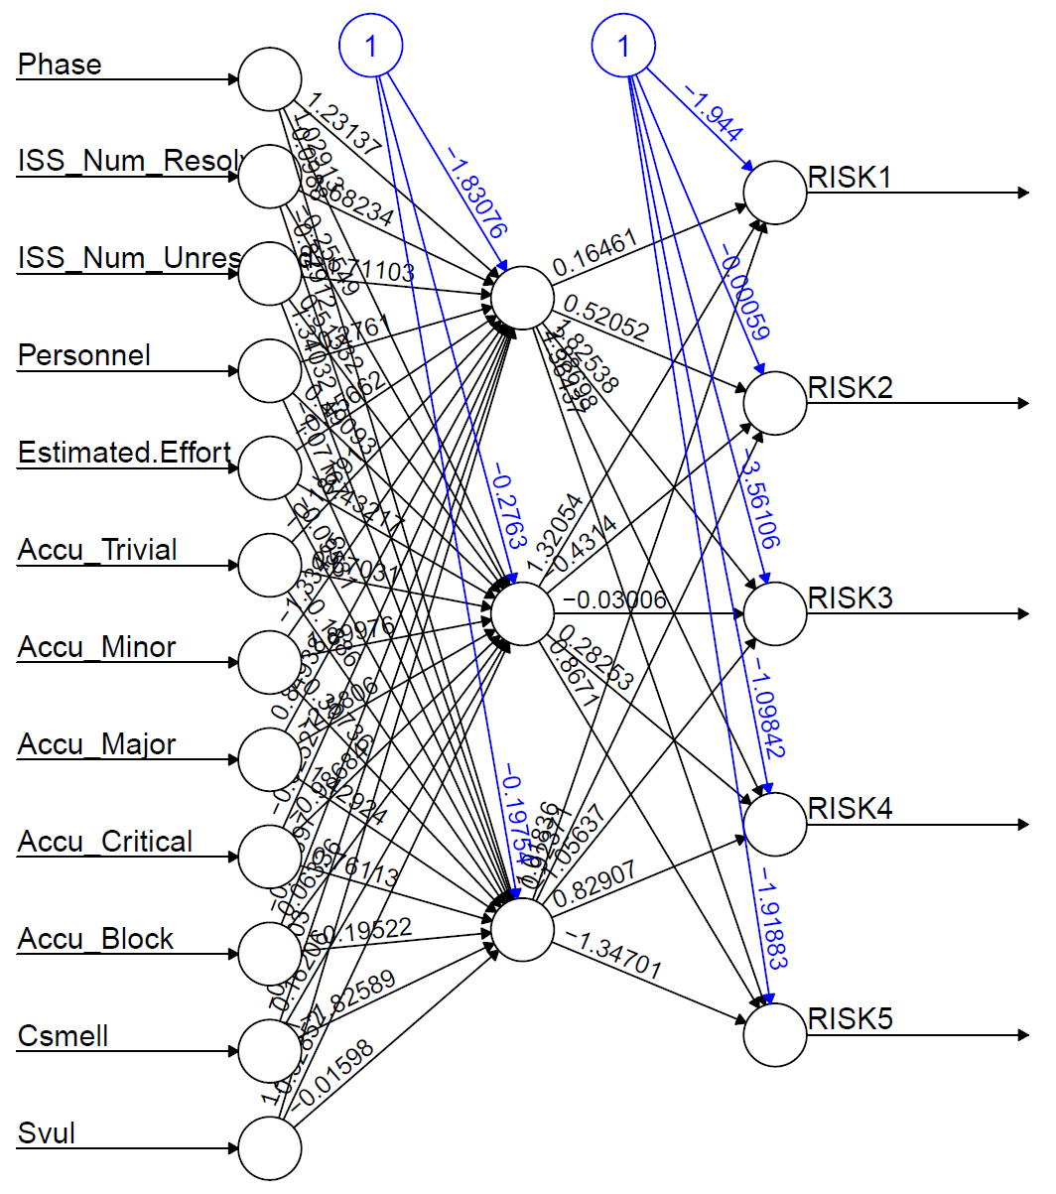
The Trained Neural Network

Slide 42
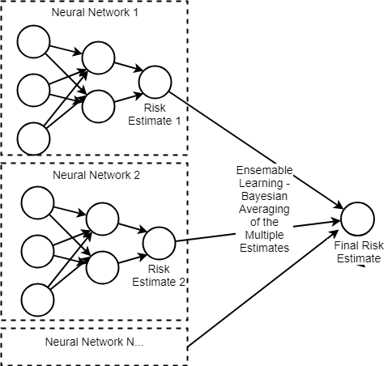
Combination of Risk Prediction Models
Bayesian Averaging on multiple risk estimates as the final estimate of risk
The final estimate of level of risk is the weighted average of the two modes. The weights are determined by the variances of each mode’s estimates.

Slide 43
Model Evaluation
Bootstrapping is applied to estimate classification rate and the confidence.
1000 resampling from the original datasets.
For each resample, classification rate (precision) is calculated and confidence level is estimated.
We have reached 48% classification accuracy on average for the combined model.
26% - 70% classification accuracy at 95% confidence level.
 | USC Model | Open Source Model | Combined Model
Classification Rate | 97% | 50% | 48%
Std. Error. | 0.017 | 0.177 | 0.112

Slide 44
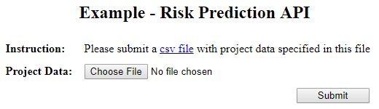
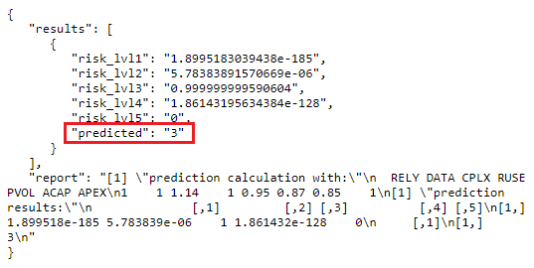
Risk Prediction Model Prototype

Slide 45

Intelligent Risk Mitigation
How to mitigate risk after the risk is predicted?
If I’m not experienced.
If I just want reduce risk to certain level.
I want to take the risk for certain purposes.

Slide 46
Knowledge Base for Mitigating Risk
Common Practice for Mitigating Risk of Different Kinds
The practices suggested by COQUALMO: Automated analysis, peer reviews, execution testing tools may be effective for different kinds of defects.
Learning from Daily Practice
E.g certain form of code review conducted by the organization may be effective for architectural technical debt.

Slide 47
Risk Mitigation Strategies
A set of actions to mitigate risk at certain phase of a project is a risk mitigation strategy. At certain point of a project, there may be multiple risk mitigation action sets that can be applied to reduce the predicted risk level.
….
Action Set 3
Action Set 2
Action Set 1
Regression Testing
Code Review
Beta Testing
...
Strategies

Slide 48
Learning the influences on risk
The effects of the candidate actions on risk are modeled as influences on factors of risk prediction model.
Action Set 1
Regression Testing
Code Review
Beta Testing
...
Action Sets

Slide 49
Select the best actions to mitigate risk
Select the best action set to mitigate risk to a certain risk level by the risk prediction model.
Action Set 1
Regression Testing
Code Review
Beta Testing
...
Action Sets

Slide 50
Demo

Slide 51
Conclusions
Operational Concept
Developed the UI prototype and risk prediction model to better explain the results/target;
Feasibility Evidence
Defined and trained the risk prediction model with available data;
Proved the technical feasibility for model training, optimization and integration to the current system.

Slide 52
Next Steps for Future Phases
Optimize the risk prediction model based on real data from pilot projects
Some management dataset may be available from certain conference, for example, ASE.
2. Define the risk mitigation actions based on development business units input.
3. Consider the possibility of integrating natural language processing of unstructured data from reports/reviews/feedback - those data may be related to risk.

Slide 53
References
Improving the accuracy of COCOMO's effort estimation based on neural networks and fuzzy logic model.
Neural Network Model For Software Size Estimation Using Use Case Point Approach
Model selection for Neural Network Classification
https://en.wikipedia.org/wiki/Artificial_neural_network
Feature selection with neural networks
Confidence Estimation Methods for Neural Networks

Slide 54
Backup Slides

Slide 55
The Three Layers - Input Layer
Group X: results from SQAaaS(Code Repository Static Analysis )
Code Smell (CSmell) and Security vulnerability (SVul)
Group Y: project settings from COCOMO and COQUALMO
22 project factors and 3 defect removal factors are used.
Group Z: runtime states from Quality Management Database and Evidence Documents
FCR (feature completion rate), CD (number of code defects), DRR (defect removal rate), ISS (number of reported issues at the feature level), ISRR (issue removal rate).
Notes:
The neurons in the group of x are related to the results from SQAaaS tool, to model the technical debt to be paid in later phases. In the initial model, the code smell and security vulnerability are used.
The neurons in the group of y are related to the cost drivers of COCOMO and ODC COQUALMO, to model the general characteristics of the project and the ability to solve risk, in terms of the process, personnel, product, and platform. In the initial model, the 22 cost drivers and 3 defect removal factors are used.
The neurons in the group of z reflect the current progress of a project, which are the metrics defined based on Quality Management Database and Evidence Documents. The metrics used in the initial model are FCR (feature completion rate), CD (number of code defects), DRR (defect removal rate), ISS (number of reported issues at the feature level), ISRR (issue removal rate).

Slide 56
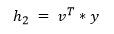
The Three Layers - Hidden Layer
Neurons in the hidden layer are the generalised representations of the inputs to reflect their influences on risk from different aspects. They are the linear combination of neurons in the input layer.
h1 models the influence from technical debt.
h2 models the influence from the general project characteristics, for example, ability to solve risk.
h3 models the current status of the project, for example, the progress of the project (avoid being over schedule or budget).

Slide 57
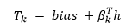
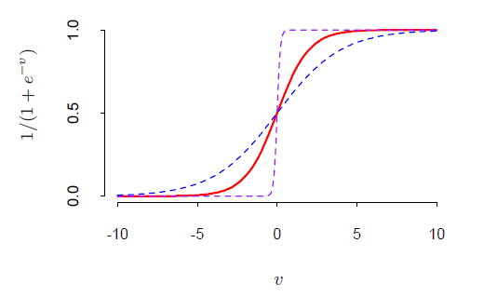
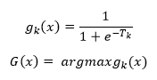
The Three Layers - Output Layer
Five units in the output layer model the five levels of risk.
The five levels of risk correspond to the five levels of risk exposure outlined in the Risk Calculator.
The target t_k are the linear combination of the inputs from the hidden layer nodes plus the bias.
The probability of each level of risk is calculated by logistic activation function. The most probable risk is output as the estimated risk level.

Slide 58
Neural Network Training and Testing Technical Details

Slide 59
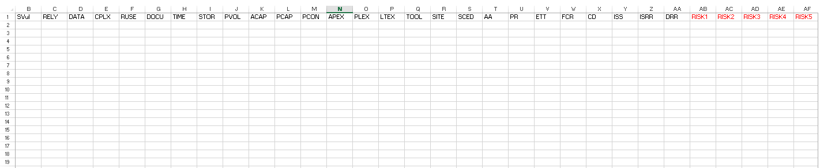
Example of the Input Data

Slide 60
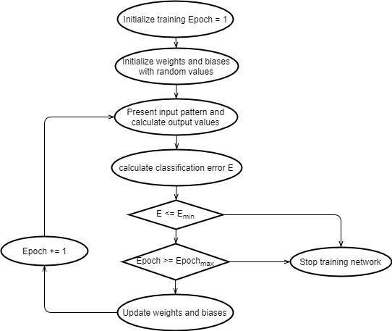
The Model Training Process

Slide 61
Model Training Method
Cost Function
To train the classifier, cross entropy cost function is used to model the error (the difference the actual and the predicted value).
Backpropagation
As the sample data input into the model, the error is propagated backwards to change the weights of the specific neurons, specifically is to minus a learning rate multiplied by the partial derivative of the error with respect to the weight.
The prediction will converge to the actual as more data points is used to train the model.

Slide 62
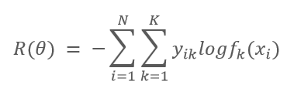
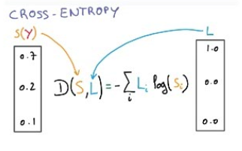
Cross Entropy as the Cost Function
Distance Measure between f(x_i) and Labels

Slide 63
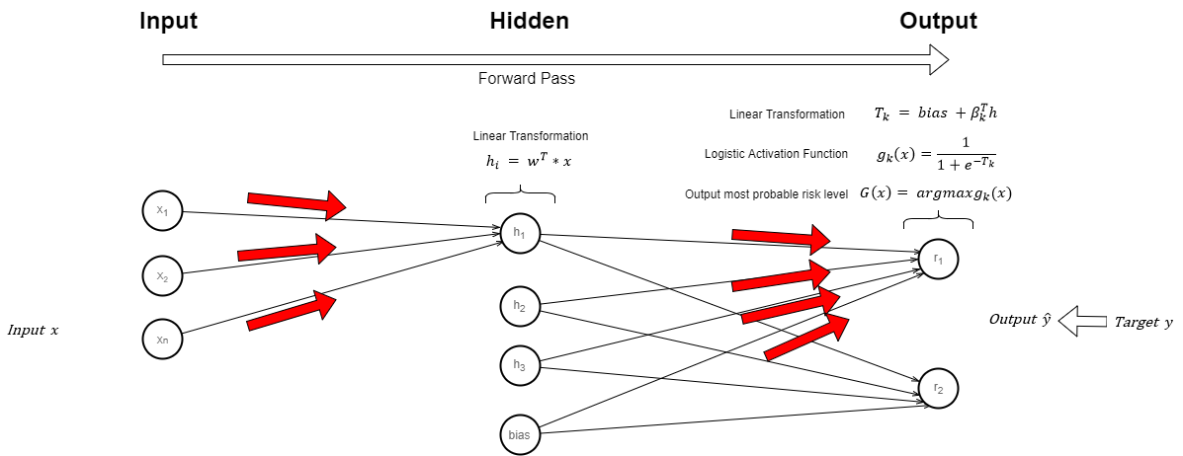
Forward Propagation

Slide 64
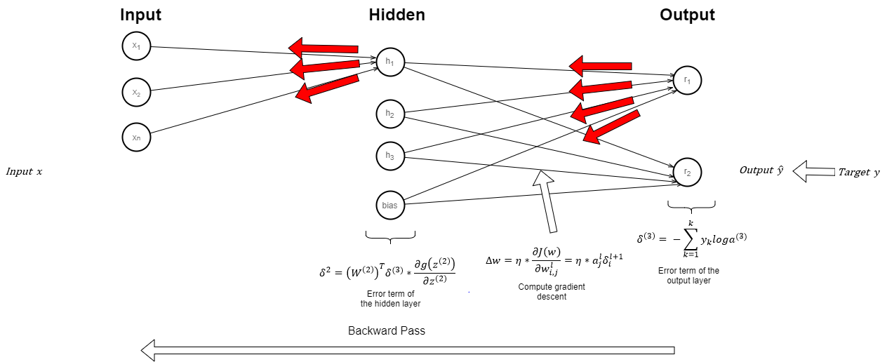
Backward Propagation

Slide 65
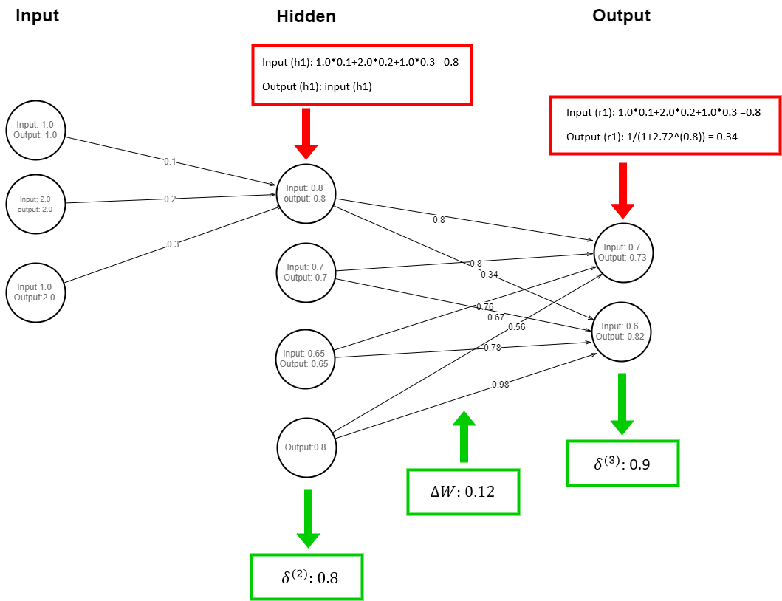
An Example of Backpropagation

Slide 66
Model Validation
A portion of the data should be used as the validation data set to decide the hyper-parameters of the neuron network, for example, the number of neurons.
If adding or removing a factor doesn’t improve the performance of the model significantly, we may remove the factor to avoid overfitting. The potential criteria are E (Classification Error Rate), BIC (Bayesian Information Criteria), AIC (AKaike Information criteria), etc.

Slide 67
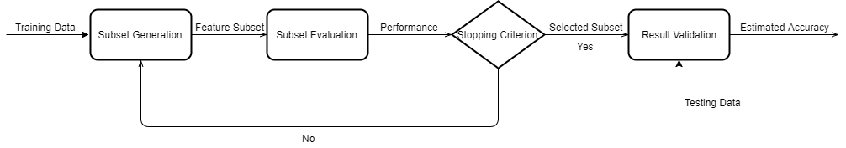
Feature Selection

Slide 68
Feature Selection
Iteratively drop the features of the trained neural network, and assess the classification accuracy against the validation data set.
Calculated the expected classification accuracy.
Rank the features with their classification accuracy.
Eliminate the least salient features according to the rank.
Calculate the drop in classification accuracy \delta A. If \delta A is smaller than \delta A_0, then output the most parsimonious set of features, otherwise go back to step 4.

Slide 69
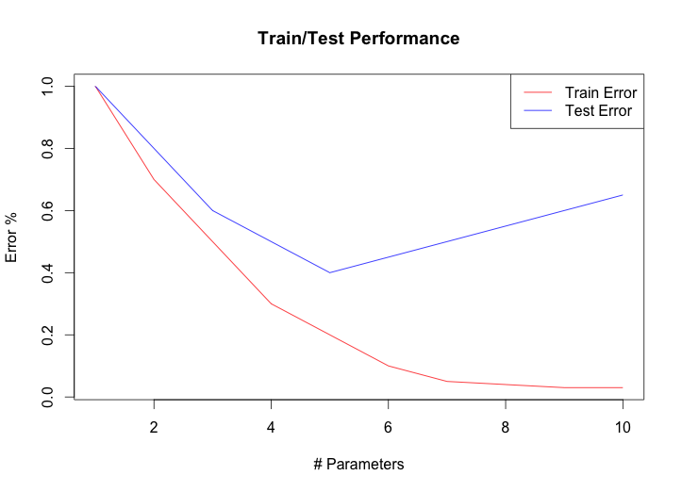
Error Rate during Feature Selection
To avoid the issue of overfitting, the number of variables in the final model equals the minimum number of parameters that produces minimum error minus 1.

Slide 70
Model Testing
For this classification model, classification error is used to evaluate the estimation accuracy.
An independent set of data need to be used to test the estimation accuracy of the model.
Cross validation or bootstrap may also be used if no enough data points available for accuracy estimation.
Using bootstrap to resample from the data set to derive sampling distribution of accuracy criterion to estimate the confidence interval.

Slide 71

Estimation of Accuracy Confidence by Bootstrapping
After 1000 (or other large number) runs of resampling from the data set, the distribution of classification accuracy can be approximated by sampling distribution.
The confidence interval of classification error rate can be estimated.

Slide 72


SQAaaS - Multi Metric View
Two metrics:
Security Vulnerabilities
Code Smells
How multiple quality attributes co-evolve?

Slide 73


Coevolution of multiple quality attributes
The information about the evolution multiple quality attributes can influence the risk.
For example
If the sum of code smells and security vulnerability issues in the system exceeds a threshold, the risk is very high
If in single commit, the sum of code smells and security vulnerabilities increase more than a threshold, the risk is very high.

Slide 74
Logic for Redirecting the Workflow
IF Risk is “Acceptable”
Go to the default activity;
ELSE IF Risk is “Too High and Unaddressable”
Restart (or stop the project);
ELSE // Risk is “High but Addressable”
Redirect to alternative activities;
Notes:
In real environment, we may have more complicated criteria, for example, we may have more ELSE IF statements to decide what to do next based on the level of Risk. Anyhow, the top idea is to quantify the risk and take action based on the risk.

